Slide 1

/
Slide 10- 1
Notes:
1

Slide 2
Chapter 10
Functional Dependencies and Normalization for Relational Databases
Copyright © 2007 Ramez Elmasri and Shamkant B. Navathe
Notes:
2

Slide 3
Chapter Outline
1 Informal Design Guidelines for Relational Databases
1.1Semantics of the Relation Attributes
1.2 Redundant Information in Tuples and Update Anomalies
1.3 Null Values in Tuples
1.4 Spurious Tuples
2 Functional Dependencies (FDs)
2.1 Definition of FD
2.2 Inference Rules for FDs
2.3 Equivalence of Sets of FDs
2.4 Minimal Sets of FDs
Slide 10- 3
Notes:
3

Slide 4
Chapter Outline
3 Normal Forms Based on Primary Keys
3.1 Normalization of Relations
3.2 Practical Use of Normal Forms
3.3 Definitions of Keys and Attributes Participating in Keys
3.4 First Normal Form
3.5 Second Normal Form
3.6 Third Normal Form
4 General Normal Form Definitions (4NF For Multiple Keys)
5 BCNF (Boyce-Codd Normal Form)
Slide 10- 4
Notes:
4

Slide 5
1 Informal Design Guidelines for Relational Databases (1)
What is relational database design?
The grouping of attributes to form "good" relation schemas
Two levels of relation schemas
The logical "user view" level
The storage "base relation" level
Design is concerned mainly with base relations
What are the criteria for "good" base relations?
Slide 10- 5
Notes:
5

Slide 6
Informal Design Guidelines for Relational Databases (2)
We first discuss informal guidelines for good relational design
Then we discuss formal concepts of functional dependencies and normal forms
- 1NF (First Normal Form)
- 2NF (Second Normal Form)
- 3NF (Third Normal Form)
- BCNF (Boyce-Codd Normal Form)
Additional types of dependencies, further normal forms, relational design algorithms by synthesis are discussed in Chapter 11
Slide 10- 6
Notes:
6

Slide 7
1.1 Semantics of the Relation Attributes
GUIDELINE 1: Informally, each tuple in a relation should represent one entity or relationship instance. (Applies to individual relations and their attributes).
Attributes of different entities (EMPLOYEEs, DEPARTMENTs, PROJECTs) should not be mixed in the same relation
Only foreign keys should be used to refer to other entities
Entity and relationship attributes should be kept apart as much as possible.
Bottom Line: Design a schema that can be explained easily relation by relation. The semantics of attributes should be easy to interpret.
Slide 10- 7
Notes:
7

Slide 8
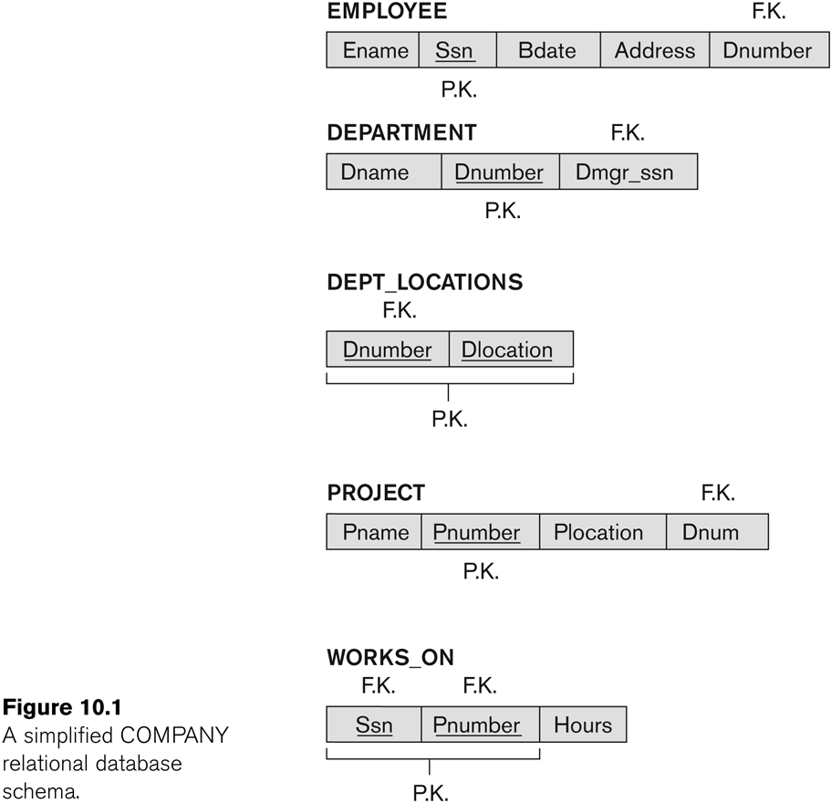
Figure 10.1 A simplified COMPANY relational database schema
Slide 10- 8
Notes:
8

Slide 9
1.2 Redundant Information in Tuples and Update Anomalies
Information is stored redundantly
Wastes storage
Causes problems with update anomalies
Insertion anomalies
Deletion anomalies
Modification anomalies
Slide 10- 9
Notes:
9

Slide 10
EXAMPLE OF AN UPDATE ANOMALY
Consider the relation:
EMP_PROJ(Emp#, Proj#, Ename, Pname, No_hours)
Update Anomaly:
Changing the name of project number P1 from “Billing” to “Customer-Accounting” may cause this update to be made for all 100 employees working on project P1.
Slide 10- 10
Notes:
10

Slide 11
EXAMPLE OF AN INSERT ANOMALY
Consider the relation:
EMP_PROJ(Emp#, Proj#, Ename, Pname, No_hours)
Insert Anomaly:
Cannot insert a project unless an employee is assigned to it.
Conversely
Cannot insert an employee unless an he/she is assigned to a project.
Slide 10- 11
Notes:
11

Slide 12
EXAMPLE OF AN DELETE ANOMALY
Consider the relation:
EMP_PROJ(Emp#, Proj#, Ename, Pname, No_hours)
Delete Anomaly:
When a project is deleted, it will result in deleting all the employees who work on that project.
Alternately, if an employee is the sole employee on a project, deleting that employee would result in deleting the corresponding project.
Slide 10- 12
Notes:
12

Slide 13
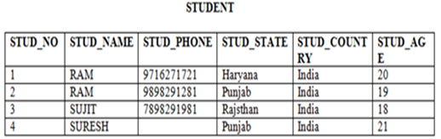
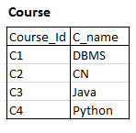
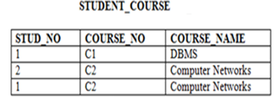
Example of Anomalies
Insertion anomaly:
If a tuple is inserted in referencing relation and referencing attribute value is not present in referenced attribute, it will not allow inserting in referencing relation.
For Example, If we try to insert a record in STUDENT_COURSE with STUD_NO =7, it will not allow.

Slide 14
Deletion and Update anomaly:
If a tuple is deleted or updated from referenced relation and referenced attribute value is used by referencing attribute in referencing relation, it will not allow deleting the tuple from referenced relation.
For Example, If we try to delete a record from STUDENT with STUD_NO =1, it will not allow.

Slide 15
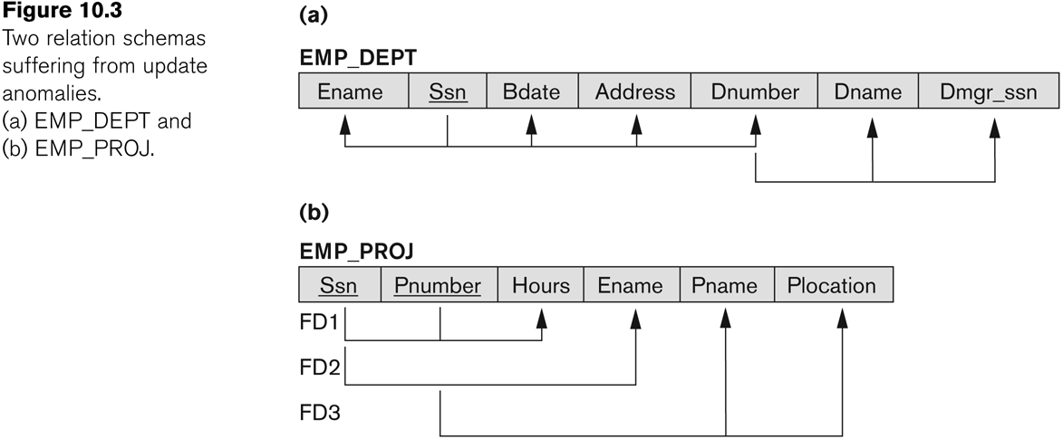
Figure 10.3 Two relation schemas suffering from update anomalies
Slide 10- 15
Notes:
15

Slide 16
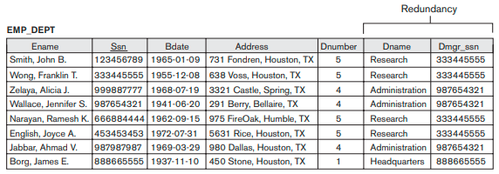
Figure 10.4 Example States for EMP_DEPT and EMP_PROJ
Slide 10- 16
Notes:
16

Slide 17
Guideline to Redundant Information in Tuples and Update Anomalies
GUIDELINE 2:
Design a schema that does not suffer from the insertion, deletion and update anomalies.
If there are any anomalies present, then note them so that applications can be made to take them into account.
Slide 10- 17
Notes:
17

Slide 18
1.3 Null Values in Tuples
GUIDELINE 3:
Relations should be designed such that their tuples will have as few NULL values as possible
Attributes that are NULL frequently could be placed in separate relations (with the primary key)
It causes confusion in COUNT and SUM operation.
If NULL value comes in comparision with SELECT or JOIN operation, the result will unpredictable.
Slide 10- 18
Notes:
18

Slide 19
Reasons for nulls:
Attribute not applicable or invalid
Attribute value unknown (may exist)
Value known to exist, but unavailable

Slide 20
1.4 Spurious Tuples
Bad designs for a relational database may result in erroneous results for certain JOIN operations
The "lossless join" property is used to guarantee meaningful results for join operations(LOS
GUIDELINE 4:
The relations should be designed to satisfy the lossless join condition i.means No spurious tuples should be generated by doing a natural-join of any relations.
Slide 10- 20
Notes:
20

Slide 21
Spurious Tuples (2)
There are two important properties of decompositions:
Non-additive or losslessness of the corresponding join
Preservation of the functional dependencies.
Note that:
Property (a) is extremely important and cannot be sacrificed.
Property (b) is less stringent and may be sacrificed. (See Chapter 11).
Slide 10- 21
Notes:
21

Slide 22
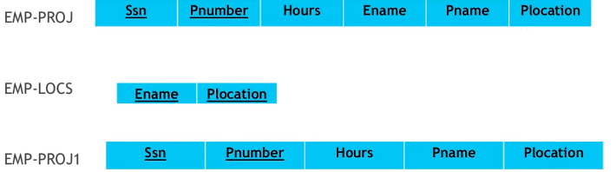
Example:
The relation EMP_PROJ is decomposed into two relations: EMP_LOCS and EMP_PROJ1.
by re-joining of these two relations will generate some spurious tuples.
So the join operation will not get original EMP_Proj relation.

Slide 23
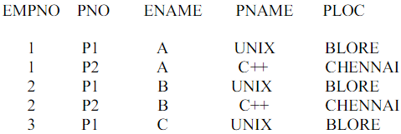
Example
Spurious Tuples Example
Consider the poorly designed relations EMP_PROJ1
This poorly designed table is split on the basis of ploc(non PK)We get EMP-LOC AND EMP-PROJ

Slide 24
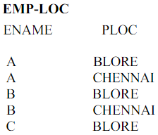
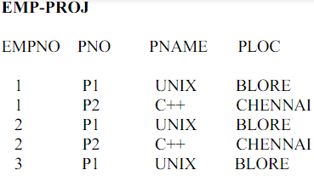
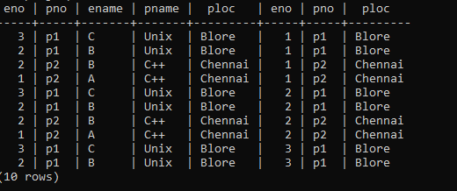
NOW IF EMP-LOC AND EMP-PROJ JOINED ON THE BASIS OF PLOC, will not get proper output
We will not get original
table.

Slide 25
2.1 Functional Dependencies (1)
Functional dependencies (FDs)
Are used to specify formal measures of the "goodness" of relational designs
And keys are used to define normal forms for relations
Are constraints that are derived from the meaning and interrelationships of the data attributes
A set of attributes X functionally determines a set of attributes Y if the value of X determines a unique value for Y
Slide 10- 25
Notes:
25

Slide 26
Keys:
1. Superkey:
All possible combination of keys are called superkeys.
Uniquely identify record.
Superkey is a superset, we can derive other keys from superkey.

Slide 27
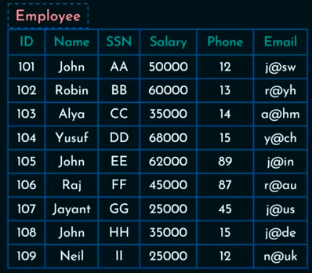
{ID},{SSN},
{ID,Name},{Name,SSN}
{ID,SSN},{ID,phone},
ID,email
Name,email
Name,ssn,email
Id,SSN,Phone
{Name,Salary}
Here, {Name,Salary} can’t become a superkey.

Slide 28
Candidate key
Minimal set of superkey.
From the following set of superkeys:
{ID},{SSN},{ID,Name},{Name,SSN},{ID,SSN},{ID,phone},
{ID,email},{Name,email},{Name,ssn,email},{Id,SSN,Phone},
{Name,Salary}
We can select candidate key (minimal set)
Such as,
{ID} and {SSN} can be a separate candidate keys.
{email}, {Name,Phone}
{ID,Name} cant be candidate key, bcz ID is a part of another candidate key.

Slide 29
Primary key
Primary key should be unique and not null
Example:
Candidate keys in above examples are:
{ID},{SSN},{Email},{Name,phone}
Primary key is :{ID} or {SSN}
Not both.
{ID} is preferred.

Slide 30
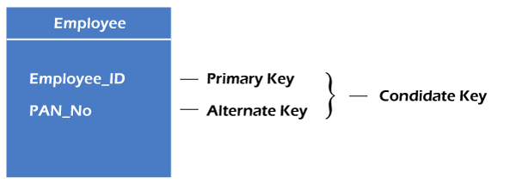
Alternate Keys
The candidate key other than primary key are called alternate keys.

Slide 31
Unique key & Composite key
It should contain unique values, but accept NULL values.
Example:
{Name,Phone} and {email} can be a unique keys.
Composite key:
Combination of Two or More attribute
Example:
{Name,Phone}
{ID,Phone}
{ID,Name}.. etc.

Slide 32
Foreign key
A foreign key in DBMS is a field that establishes and maintains a link between two separate tables.
It acts as a constraint ensuring data and referential integrity within relational databases.
Using foreign keys ensures that the data stored in different tables are consistent, helping maintain the relationship between the two tables while preventing any unauthorized modifications.
In addition, they can also be used to create connections among multiple entities to organize information for better retrieval from the database.

Slide 33
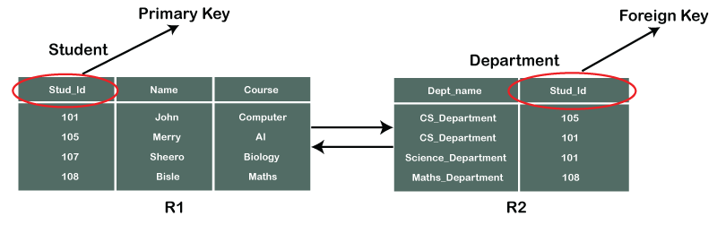
Example
This foreign key relationship ensures referential integrity between the two tables.
It means that every value in the Stud_id column of the Department table must correspond to a valid Stud_id in the Student table.
For example, you can't insert a record into the Department table with a Stud_id that doesn't exist in the Courses table. This helps to maintain consistency

Slide 34
Proper subset:
A proper subset of a set A is a subset of A that is not equal to A.
In other words, if B is a proper subset of A, then all elements of B are in A but A contains at least one element that is not in B.
if A={1,3,5} then B={1,5} is a proper subset of A.
The set C={1,3,5} is a subset of A, but it is not a proper subset of A since C=A.
Example:
Let us consider in relation R(A,B,C,D),
If {A,B,C} is a super key, then proper subset of this super key are:
{A},
{B}
{C}
{A,B}
{A,C}
{B,C}

Slide 35
Functional Dependencies (2)
X -> Y holds if whenever two tuples have the same value for X, they must have the same value for Y
For any two tuples t1 and t2 in any relation instance r(R): If t1[X]=t2[X], then t1[Y]=t2[Y]
X -> Y in R specifies a constraint on all relation instances r(R)
Written as X -> Y; can be displayed graphically on a relation schema as in Figures. ( denoted by the arrow: ).
FDs are derived from the real-world constraints on the attributes
Slide 10- 35
Notes:
35

Slide 36
Examples of FD constraints (1)
Social security number determines employee name
SSN -> ENAME
Project number determines project name and location
PNUMBER -> {PNAME, PLOCATION}
Employee ssn and project number determines the hours per week that the employee works on the project
{SSN, PNUMBER} -> HOURS
Slide 10- 36
Notes:
36

Slide 37
Examples of FD constraints (2)
An FD is a property of the attributes in the schema R
The constraint must hold on every relation instance r(R)
If K is a key of R, then K functionally determines all attributes in R
(since we never have two distinct tuples with t1[K]=t2[K])
Slide 10- 37
Notes:
37

Slide 38
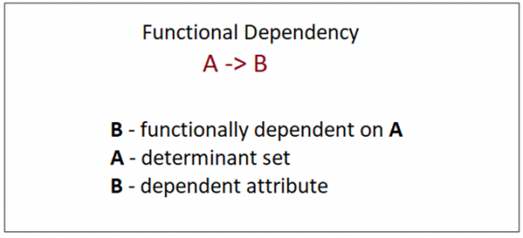
functional dependency
The functional dependency is a relationship that exists between two attributes, where one set can accurately determine the value of other sets.
It is denoted as X → Y, where X is a set of attributes that is capable of determining the value of Y.
X is called Determinant, while on the right side, Y is called the Dependent.

Slide 39
Example
Assume we have an employee table with attributes:
Emp_Id, Emp_Name, Emp_Address.
Here Emp_Id attribute can uniquely identify the Emp_Name attribute of employee table because if we know the Emp_Id, we can tell that employee name associated with it.
Functional dependency can be written as:
Emp_Id → Emp_Name
We can say that Emp_Name is functionally dependent on Emp_Id.

Slide 40
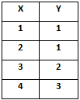
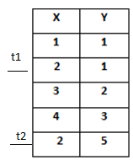
Example
In this example,
if t1.x= 2 t2.x = 2 true
Then t1.Y=1 t2.Y =5 false
FD: X -> Y
FD: if t1.X = t2.X
then t1.Y = t2.Y
Here,
if t1.x= 1 t2.x = 2 false

Slide 41
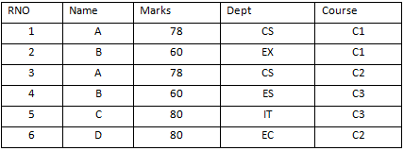
Consider the following table:
RNO -> Name
FD
Name -> RNO
FD doesn’t exist
RNO -> Marks
FD exist
Name –Marks
FD exist
Dept -> Course
FD doesn’t exist
Marks -> Dept
FD doesn’t exist
{RNO, Name} -> Marks
FD exist
{Name, Marks} -> Dept
FD doesn’t exist

Slide 42
2.3 Equivalence of Sets of FDs
Two sets of FDs F and G are equivalent if:
Every FD in F can be inferred from G, and
Every FD in G can be inferred from F
Hence, F and G are equivalent if F⁺ =G⁺
Definition (Covers):
F covers G if every FD in G can be inferred from F
(i.e., if G⁺ subset-of F⁺)
F and G are equivalent if F covers G and G covers F
There is an algorithm for checking equivalence of sets of FDs
Slide 10- 42
Notes:
42

Slide 43
2.4 Minimal Sets of FDs (1)
A set of FDs is minimal if it satisfies the following conditions:
Every dependency in F has a single attribute for its RHS.
We cannot remove any dependency from F and have a set of dependencies that is equivalent to F.
We cannot replace any dependency X -> A in F with a dependency Y -> A, where Y proper-subset-of X ( Y subset-of X) and still have a set of dependencies that is equivalent to F.
Slide 10- 43
Notes:
43

Slide 44
Minimal Sets of FDs (2)
Every set of FDs has an equivalent minimal set
There can be several equivalent minimal sets
There is no simple algorithm for computing a minimal set of FDs that is equivalent to a set F of FDs
To synthesize a set of relations, we assume that we start with a set of dependencies that is a minimal set
E.g., see algorithms 11.2 and 11.4
Slide 10- 44
Notes:
44

Slide 45
2.2 Inference Rules for FDs (1)
Given a set of FDs F, we can infer additional FDs that hold whenever the FDs in F hold
Armstrong's inference rules:
IR1. (Reflexive) If Y subset-of X, then X -> Y
If X ⊆ Y then X → Y
Example:
{Rno,Name} -> Name
Here , name is a subset of {rno, name}
IR2. (Augmentation) If X -> Y, then XZ -> YZ
(Notation: XZ stands for X U Z)
Slide 10- 45
Notes:
45

Slide 46
IR3. (Transitive) If X -> Y and Y -> Z, then X -> Z
IR1, IR2, IR3 form a sound and complete set of inference rules
These are rules hold and all other rules that hold can be deduced from these

Slide 47
Inference Rules for FDs (2)
Some additional inference rules that are useful:
Decomposition: If X -> YZ, then X -> Y and X -> Z
Union: If X -> Y and X -> Z, then X -> YZ
Psuedotransitivity: If X -> Y and WY -> Z, then WX -> Z
The last three inference rules, as well as any other inference rules, can be deduced from IR1, IR2, and IR3 (completeness property)
Slide 10- 47
Notes:
47

Slide 48
Inference Rules for FDs (3)
Closure of a set F of FDs is the set F⁺ of all FDs that can be inferred from F
Closure of a set of attributes X with respect to F is the set X⁺ of all attributes that are functionally determined by X
X⁺ can be calculated by repeatedly applying IR1, IR2, IR3 using the FDs in F
Slide 10- 48
Notes:
48

Slide 49
Types of Functional dependencies
Full dependency
Partial dependancy
Trivial functional dependency
Non-Trivial functional dependency
Multivalued functional dependency
Transitive functional dependency

Slide 50
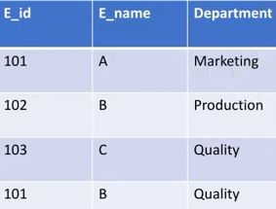

Fully functional dependency
An attribute is fully functional dependent on X and if Y is FD on X but not FD on any proper subset of X.
Here, Eid -> Dept and E_name ->Dept, these 2 functional dependencies doesn’t exist.
Hence ,
Dept is completely depend on {Eid,Ename}.

Slide 51
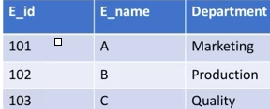
Partial functional dependency
An attribute is fully functional dependent on X and if Y is FD on X but not FD on any proper subset of X.
Here, Eid -> Dept and E_name ->Dept, these 2 functional dependencies exist (individually).
That means either Eid or Ename can determine Dept.
Hence ,
Dept is partially depend on {Eid,Ename}.

Slide 52
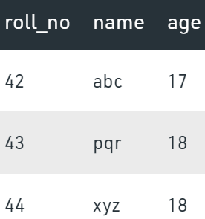
Trivial Functional Dependency:
In , a dependent is always a subset of the determinant. i.e. If X → Y and Y is the subset of X, then it is called trivial functional dependency
For example,
Here, {roll_no, name} → name is a trivial functional dependency, since the dependent name is a subset of determinant set {roll_no, name} Similarly, roll_no → roll_no is also an example of trivial functional dependency.

Slide 53
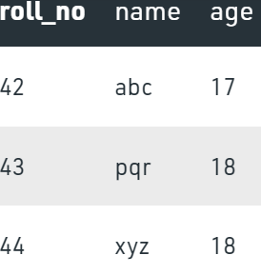
Non-trivial Functional Dependency
In Non-trivial functional dependency, the dependent is strictly not a subset of the determinant.
i.e. If X → Y and Y is not a subset of X, then it is called Non-trivial functional dependency.
For example,
Here, roll_no → name is a non-trivial functional dependency, since the dependent name is not a subset of determinant roll_no
Similarly, {roll_no, name} → age is also a non-trivial functional dependency, since age is not a subset of {roll_no, name}

Slide 54
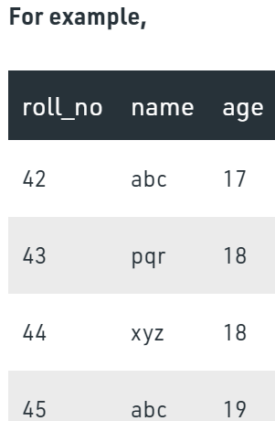
Multivalued Functional Dependency
In Multivalued functional dependency, attributes of the dependent set are not dependent on each other.
i.e. If a → {b, c} and there exists no functional dependency between b and c, then it is called a multivalued functional dependency.
Here, roll_no → {name, age} is a multivalued functional dependency, since the dependents name & age are not dependent on
each other(i.e. name → age or age → name doesn’t exist !)

Slide 55
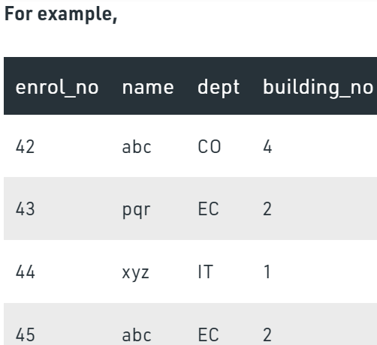
Transitive Functional Dependency
In transitive functional dependency, dependent is indirectly dependent on determinant. i.e. If a → b & b → c, then according to axiom of transitivity, a → c. This is a transitive functional dependency
Example:
Here, enrol_no → dept and dept → building_no,
Hence, according to the axiom of transitivity, enrol_no → building_no is a valid functional dependency.
This is an indirect functional dependency, hence called Transitive functional dependency.

Slide 56
Find superkeys
If we have ‘N’ attributes with one candidate key then the number of possible superkeys is 2^{(N – 1)}.
Example:
Let's say we have a relation R with attributes {a1, a2, a3} and a1 is the candidate key.
Then, any superset of a1 is the super key.
Here n=3, thus, we can have 2^{(3– 1)=} 2^{^2= 4 ,}
four possible super keys: {a1, a1 a2, a1 a3, a1 a2 a3}.

Slide 57
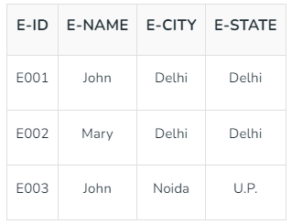
Examples
Steps to Find the Attribute Closure:
Given the FD set of a Relation R, The attribute closure set S is the set of Attribute Closure A.
Add A to S.
Recursively add attributes that can be functionally
determined from attributes of the set S until done.
From Table 1, FDs are
Given R (E-ID, E-NAME, E-CITY, E-STATE) FDs = { E-ID->E-NAME, E-ID->E-CITY, E-ID->E-STATE, E-CITY->E-STATE }

Slide 58
The attribute closure of E-ID can be calculated as:
Add E-ID to the set {E-ID}
Add Attributes that can be derived from any attribute of the set.
As there is one other attribute remaining in relation to be derived from E-ID.
So the result is:
(E-ID)+ = {E-ID, E-NAME, E-CITY, E-STATE }

Slide 59
Similarly,
(E-NAME)^{+ = {E-NAME}}
(E-CITY)^{+ = {E-CITY, E_STATE}}
(E-STATE)^{+ = { E_STATE}}

Slide 60
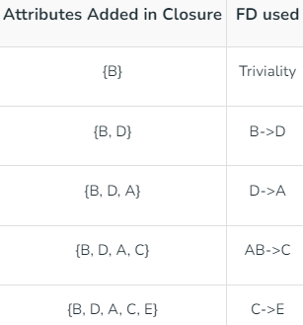
Example
Find the attribute closures of (B)⁺ ,given FDs R(ABCDE) = {AB->C, B->D, C->E, D->A}.
(B)⁺ = {B}
= {B,D}
={ B,D,A}
={B,D,A,C}
={B,D,A,C,E}

Slide 61
Closure of FD EXAMPLE’S
Ex1. To find Candidate keys
R(ABCD)
FD: {A🡪B,B🡪C,C🡪D}
Ans:
Closure of A means what A determines.
Find closure of all attributes:
A⁺= {A,B,C,D} S.K
B⁺={B,C,D}
C⁺={C,D}
D⁺={D}
AB⁺={ABCD} S.K
AC⁺ = {ABCD} S.K
AD⁺ = ABC⁺ = ABD⁺ = ACD^{+ . . .} S.K
CK={A}
PRIME ATTRIBUTE:
The set of attributes makes candidate key are called prime attributes.
Here,
Prime attributes are : {A}
Non –prime: {B,C,D}
Hence, candidate key is A.

Slide 62
Example
Given Relation R(A,B,C,D,E) & FD: {A🡪B, D🡪E}
ABCDE⁺ = {A,B,C,D,E} S.K
ACDE⁺ = {A,B,C,D,E} S.K
ACD⁺ = {A,B,C,D,E} S.K
How to check ACD is only the candidate key.
Prime attributes: {A,C,D}
Check any of the prime attribute is available in R.H.S of Functional Dependency i.e A,C & D
No any prime attribute is present in RHS. So we can say that is the only candidate key {ACD}.

